Slide 1
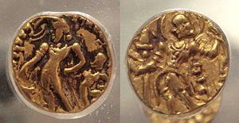
Gupta Empire
Golden Age in India 320-550 C.E.

Slide 2
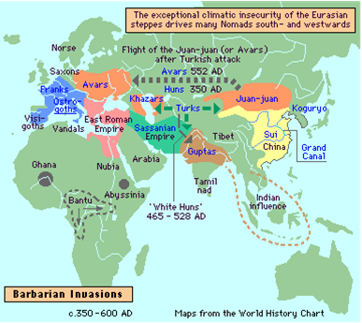
Revival of Native Indian Rule
For 500 years prior to 320 C.E., India ruled by foreign invaders: Greeks, Persians, Scythians, Kushans.
By 320 Gupta family dynasty creates strong government capable of repelling barbarian invasions
ChandraGupta I first “Majaraja” or “Great King.” Ruled 319-335 C.E.. Unifies through strategic marriage and conquest.

Slide 3
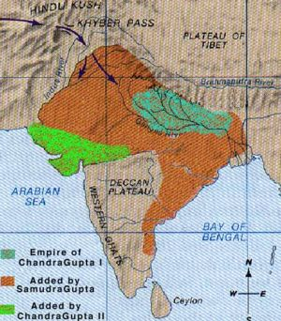
SamudraGupta 335-380 C.E.
Cakravartin or “Wheel Turner.” Circuit of conquest like the sun.
Conquered more than 20 kingdoms. But re-instated his defeated enemies as tributary kings. Skilled statesman.
Built army and even navy.
Devout Hindu worshipper of Vishnu. Revived ancient Vedic rites such as Horse Sacrifice.
Yet tolerant of Buddhism
Wealth “rightfully acquired.” Not oppressive.
Great patron of literature and arts. Poet and musician himself.
Revived Sanskrit as sacred language.

Slide 4
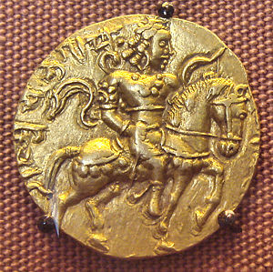
ChandraGupta II 380-413
Built coast-to coast empire. Emphasized alliances and strategic marriages. Created new Western capital, Ujjain. Height of Empire.
Master of compromise in
politics, diplomacy, religion.
Tolerance of Buddhism and
Jainism. Built monasteries and
gave government posts to
religious minorities.
Built efficient bureaucracy.
Chinese pilgrims report
absence of corporal punish-
ment, poll or land taxes. Fixed salaries for soldiers.

Slide 5
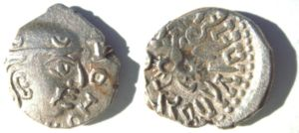
Later Emperors
Generally considered less brilliant than ChandraGupta I and II and SamudraGupta
Possible exception: SkandaGupta. Crushed rebellion of Pushyamitra tribe and was able to hold off threat of invading Huns.
Wars however drained empires wealth, contributing to decline. Internal dissension increases.
Huns returned and over-ran empire by 500 C.E.. Gupta kings resisted until last reign, 540-550.

Slide 6
Gupta Social Order
Guptas, despite tolerance, were profoundly conservative in social questions.
Upheld caste system.
Peasants forced to stay on their land. No mobility.
Emphasis on harmony and balance.
Ex. Kalidasa: love follows caste lines
Economic complexity → sub-castes, or jati, based on occupation.
Connected: rise of guilds, organizations which supervise an industry’s wages and prices, provide welfare for needy members and families.

Slide 7
Economy
Gupta kings empower merchant vaisya caste
Elaborate coinage system developed.
Trade expands. Flourishing trade with Rome, China, Arabian world.
In many cities marketplaces surge.
BUT still essentially an agricultural economy
Feudal pattern begins as kings make land grants to Brahmins. After Gupta period, these land grants are increasingly made to Kshatriya or warrior caste.
Advances in agriculture: iron permits clearing of Ganges River valley for farming.

Slide 8
Intellectual Advances
Translation of works of Greek astronomy into Sanskrit. By 499 past, future planet locations calculated accurately, solar year measured.
Geography: world longitudes redrawn, beginning in Ujjain instead of Alexandria.
Math: World’s first effective treatises on square and cubed roots. Numeral and decimal system developed which spread eventually to Europe.
Philosophy: Formal logic developed. Use of syllogism.
Medicine: Free hospitals provided. Advances in bone-setting and pharmacy soon adopted by Arabs and Greeks.
Great universities of Nalanda and Vikramasila established, receive influx of students from all the world.

Slide 9
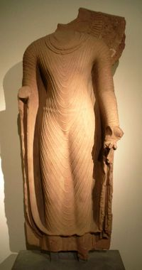
Gupta Art
Tolerance led to flowering of Buddhist Art under Gupta Dynasty.
Distinctive Gupta Buddhist style. Figures were elongated, idealized. Faces had distant, meditative gazes.
Expressed ideals of restraint, discipline, harmony.

Slide 10
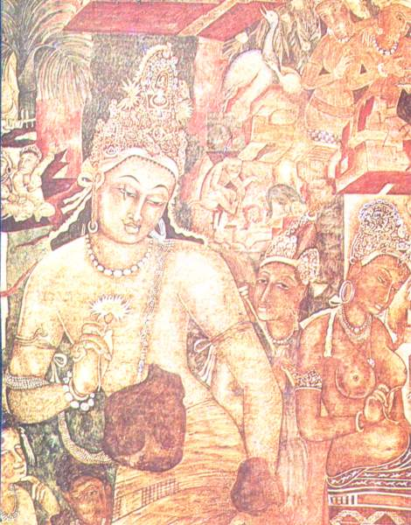
Gupta Art
Characterized by “a turning inward, an ability to communicate higher spiritual states…”
Most famous paintings are from Ajanta Caves. Supported by a kingdom aligned with the Guptas through marriage, usually understood as part of Gupta legacy.

Slide 11
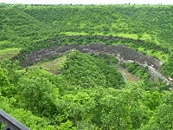
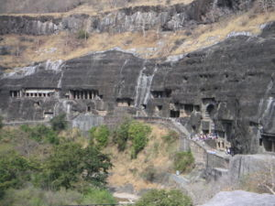
Gupta Art: Ajanta Cave Paintings
29 Caves in horseshoe shaped rock ravine
Oldest caves may date to 2nd Century B.C.E, while other caves made as late as 7th Century C.E.. Most made in 5th and 6th Centuries.
Sponsored by Gupta- allied Vakataka Dynasty.

Slide 12
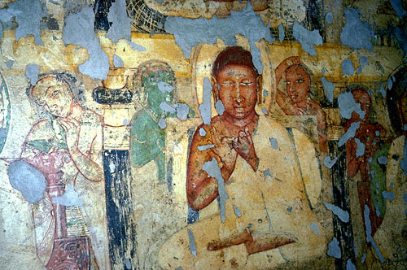
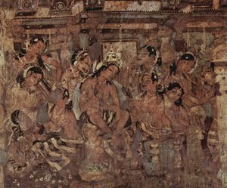
Gupta Art: Ajanta Cave Paintings
Some caves seem influenced by Therevada Buddhist prohibition on representing the Buddha. Above is from a series of didactic paintings based on the Jataka.
Later caves trace transition to Mahayana Buddhism.

Slide 13
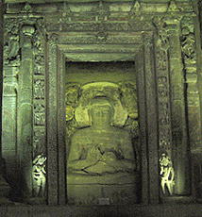
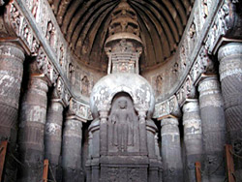
Gupta Art: Ajanta Cave Sculpture

Slide 14
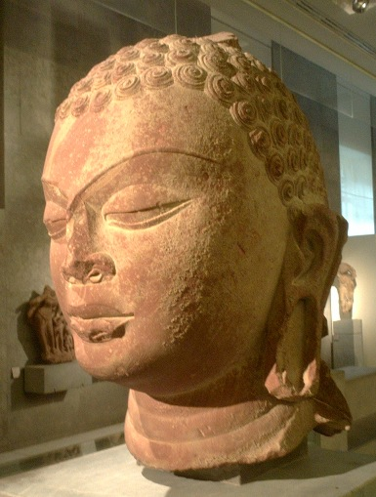
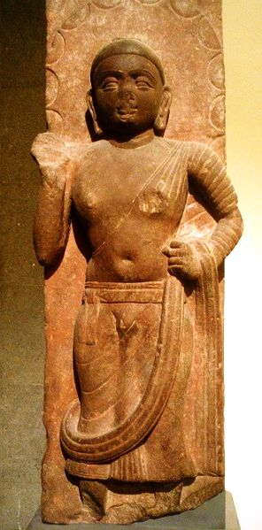
Gupta Art: Mathura Style
Early and influential style of representing the Buddha emerges from north Indian city of Mathura
Abhaya Mudra
Broad shoulders, spread feet, elongated body
Hair shaved or in flat spirals

Slide 15
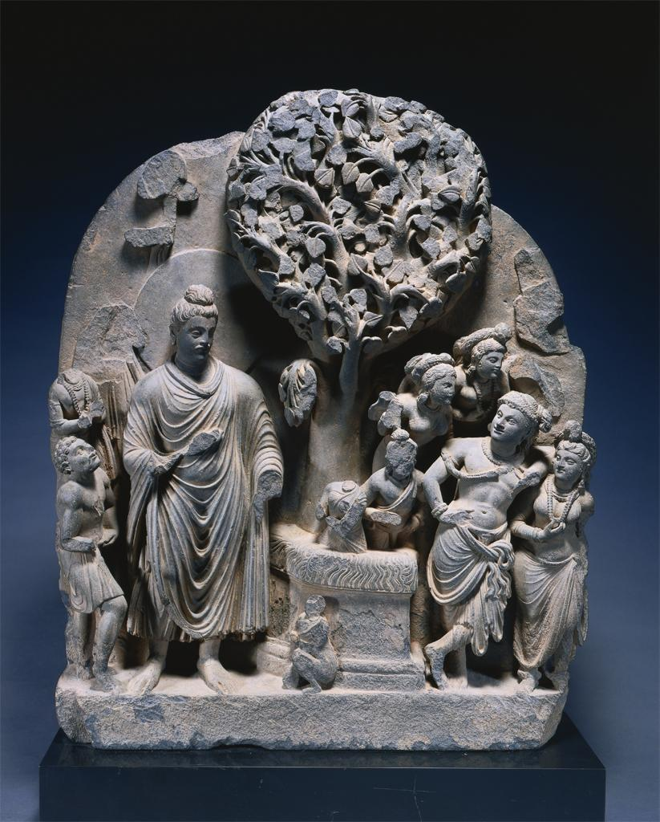

Slide 16
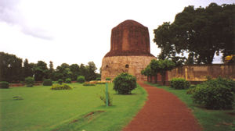
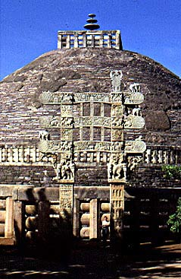
Gupta Architecture: the Stupa
Originally the Buddha’s burial mound. Function was remembrance → simple clay mound
Gradually becomes site of worship → more elaborate form, with spires, gates, walkways and sculpture
Guptas renovate and elaborate upon stupas from Ashoka’s age.

Slide 17
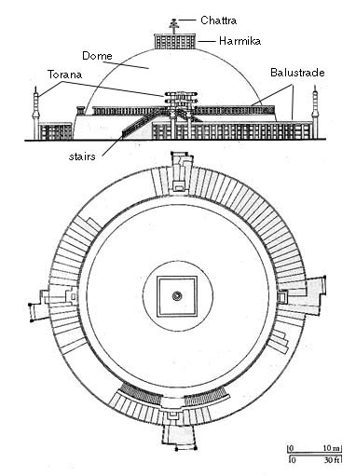
Parts of a Stupa

Slide 18
Hindu Temples
Imagined as houses. Resident and owner is deity. Priests are live-in servants.
Sculptures adorning temples often tell stories about the deity “inside”
Murtis : images of a deity, meant to inspire reverence.

Slide 19
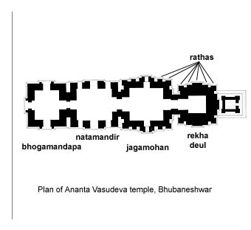
Dance pavilion
Entrance
(shrine)
(offering hall)
(entry hall)

Slide 20
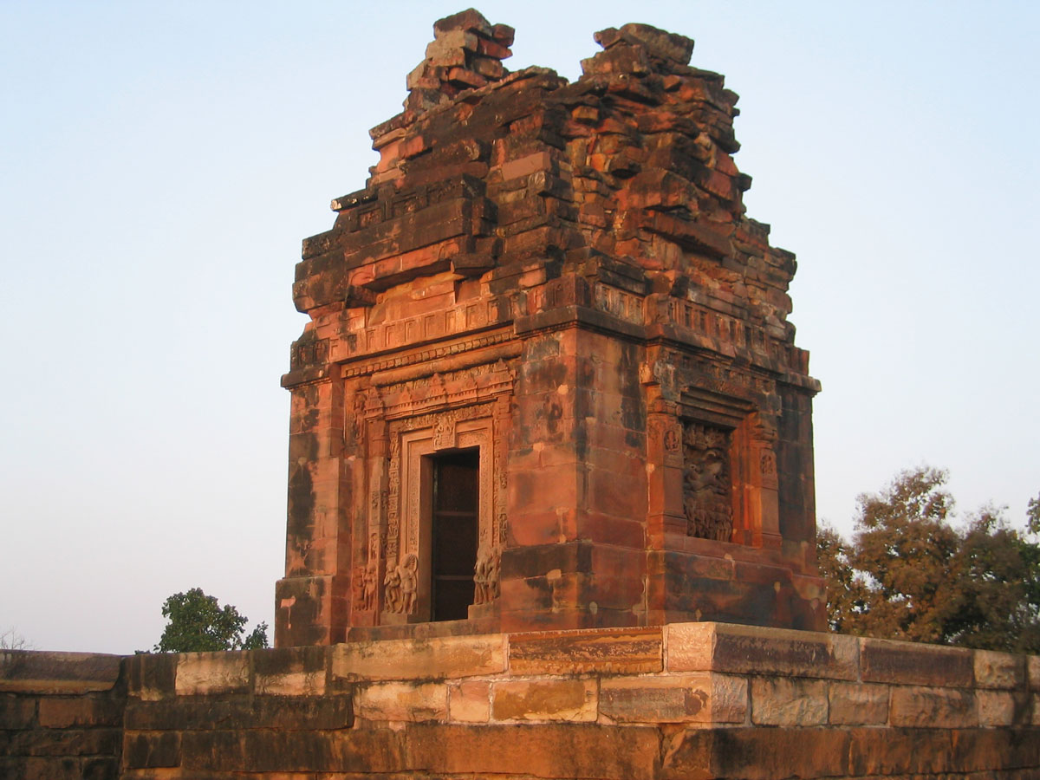
Gupta Religion and Art: Hindu Temples
The Dasavatar Temple (late Gupta period, 500's)

Slide 21
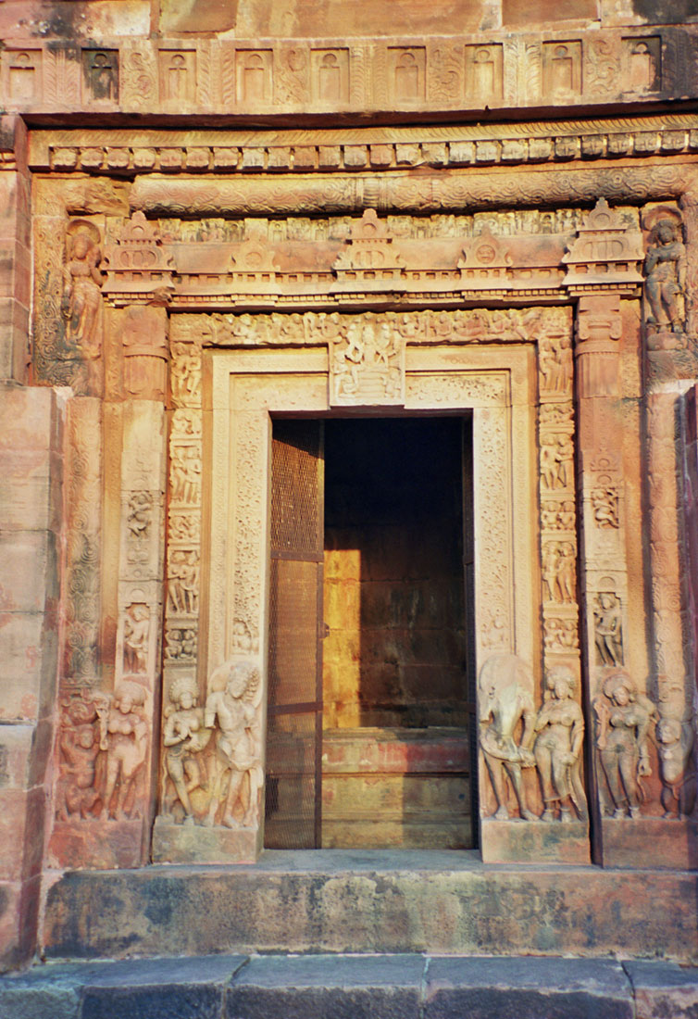
A closer view of the entry-way

Slide 22
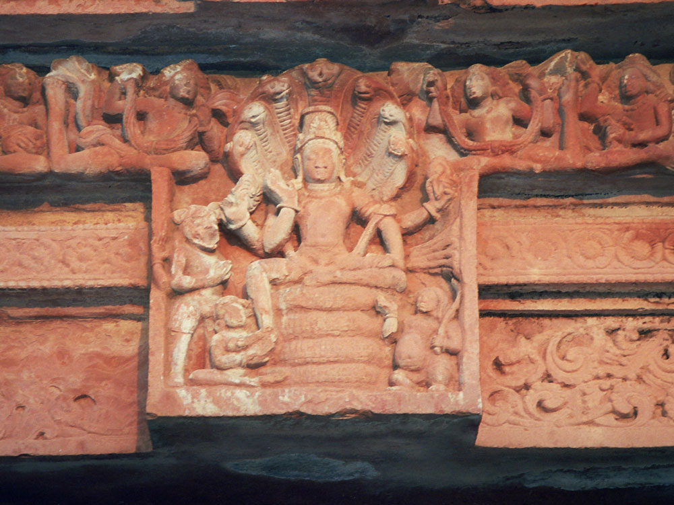

Slide 23
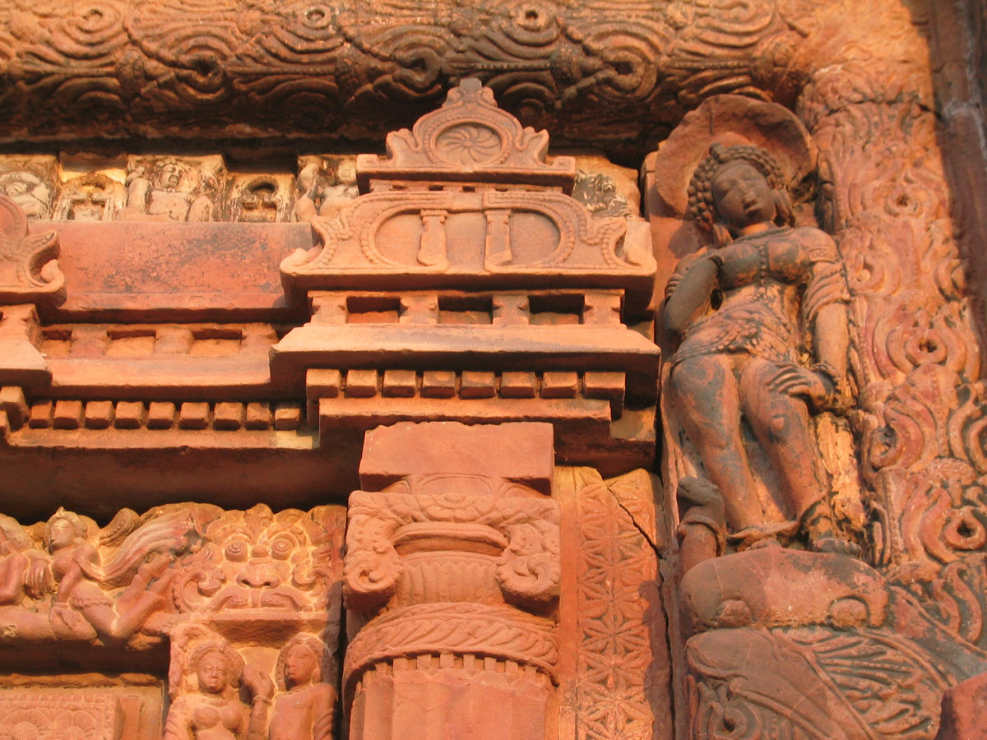

Slide 24
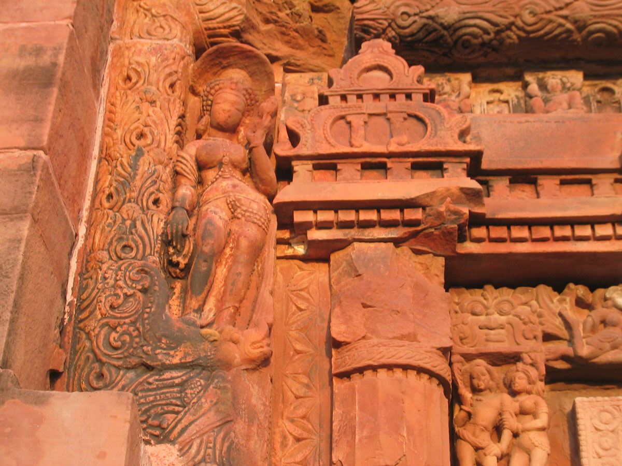

Slide 25
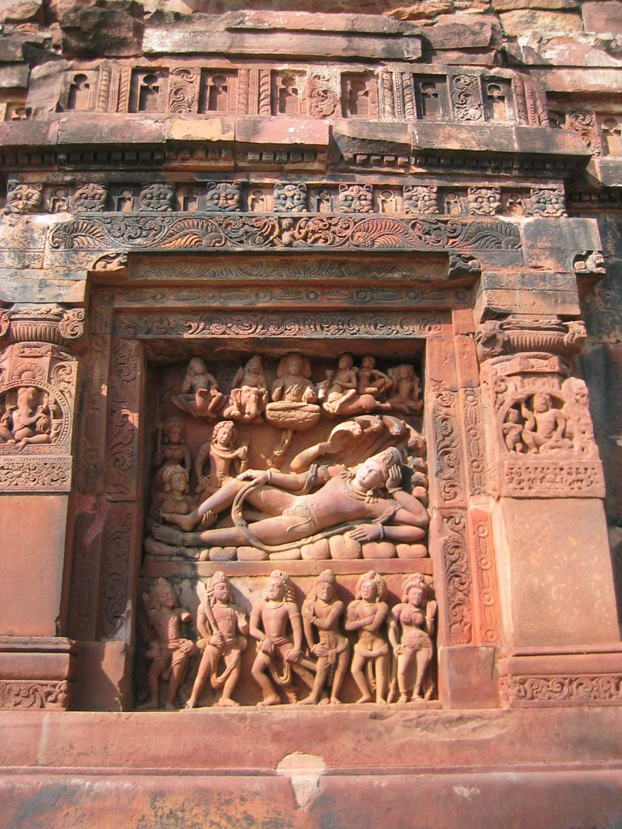
Vishnu reclining on Shesha

Slide 26
